Slide 1
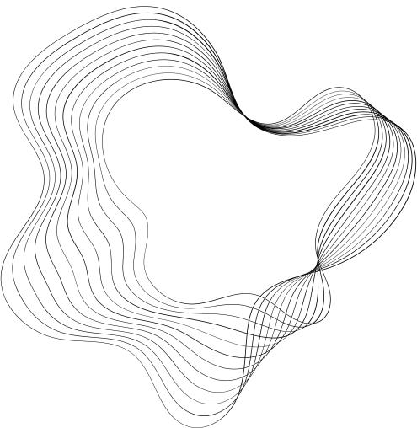

ITU - AI4G - TINYML01
SMART WEATHER STATION
HTTPS://SMART-WEATHER-STATION-AB.NETLIFY.APP/
BY - ADN INNOVATORS

Slide 2
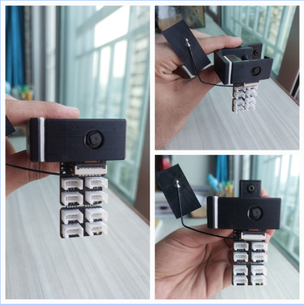



PROBLEM STATEMENT
To reduce the dependency on traditional weather instruments that involve moving parts such as an anemometer. Innovate a smart weather station.
The measurements must be accurate, predictions must be precise and in accordance with the actual ground values.

Slide 3





GOALS AND OBJECTIVES
Collect Data
Model Training
Results
Collect the relevant data regarding rainfall declare the number of classes. Make sure the data is sufficient for accurate precise predictions.
Set up the model with required parameters , generate the features for collected data and monitor the training requirements - training time, train/validation accuracy.
Create a dashboard for the outputs of respective measurement values as well as classification analysis.

Slide 4

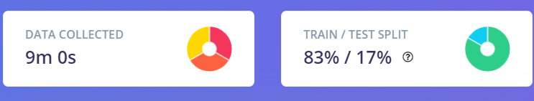

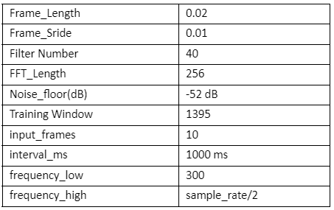
DATASET
Total collected data is training data = 9 mins + test data = 1.5 mins
classified into 3 classes -
High Rainfall
Moderate - Mid Rainfall
Low Rainfall
CUSTOMERS

Slide 5
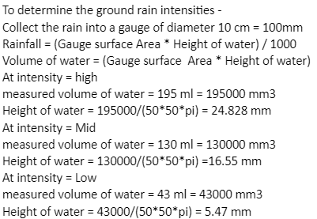
DATASET - ANALYSIS
CUSTOMERS
Total collected data is training data = 9 mins + test data = 1.5 mins
classified into 3 classes -
High Rainfall
Moderate - Mid Rainfall
Low Rainfall

Slide 6
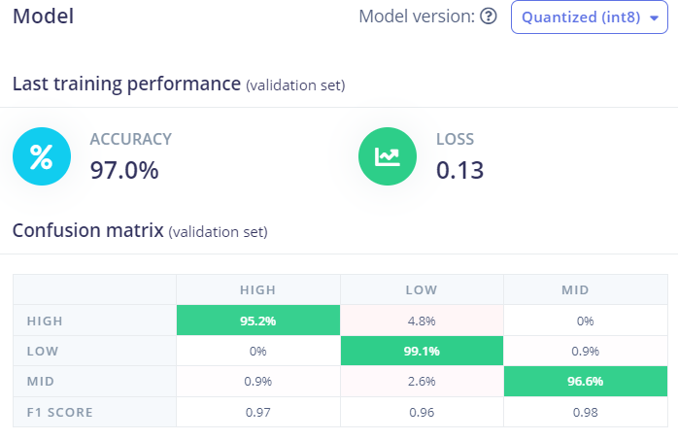
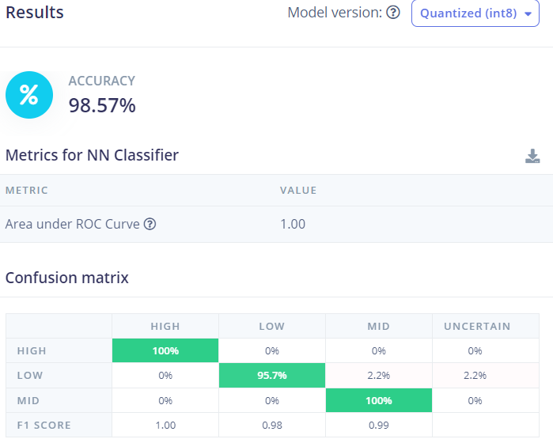
MODEL ACCURACY

Slide 7
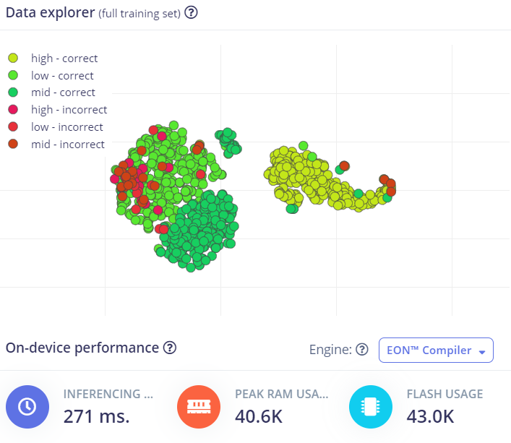
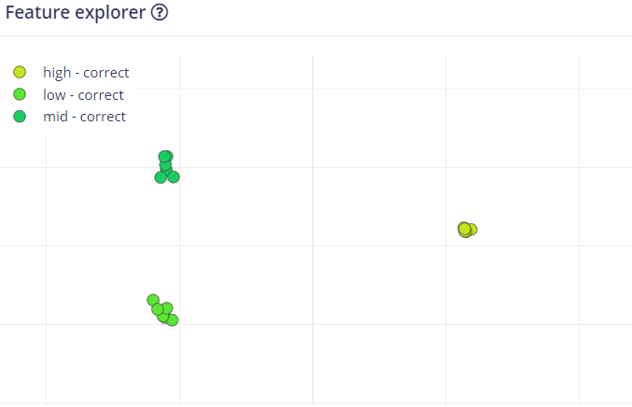
MODEL ACCURACY

Slide 8
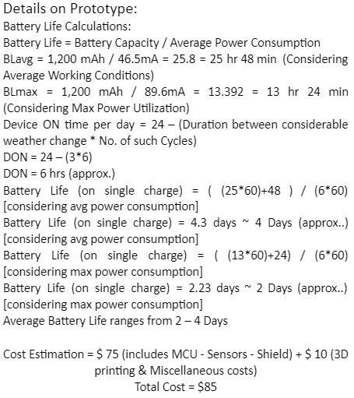
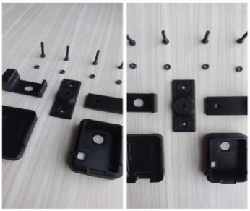
DEPLOYMENT

Slide 9
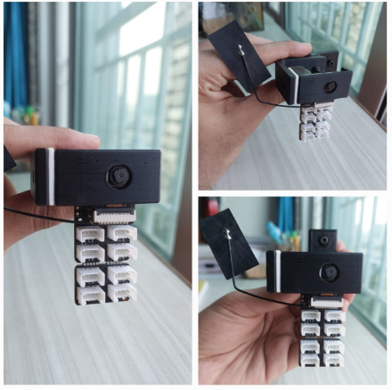
THANK YOU

